Slide 1

Sports Betting
Starting Lineup:
Point Guard – Enyo
Power Forward – Ric
Center - Welchman

Slide 2

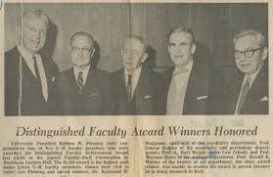



Slide 3
“Good teams win; Great teams cover.”
Ancient Klingon Proverb

Slide 4
Questions We asked
What analytics and statistics are important to basketball? What makes a good team?
Do good teams always end up winning? Does talent matter?
What statistics correlate with number of wins?
What statistics should one use when making bets?
What statistics are needed to create a solid prediction system for the outcome of the games?

Slide 5

What is Basketball?
Merriam-Webster defines basketball as…

Slide 6
What is Basketball?
Wikipedia defines basketball as…

Slide 7
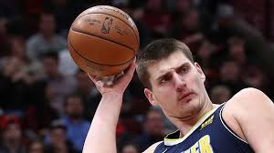
lol his nickname is joker lmao

Slide 8
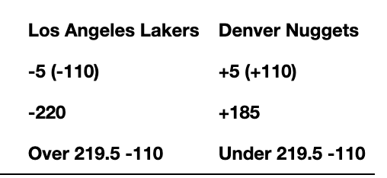
Gambling 101 (or An Introduction into Degeneracy)
Spread
Money line
Over/Under

Slide 9
Gambling 101 (or An Introduction into Degeneracy)
$190.91 | $210.00
$145.45 | $285.00
$190.91 | $190.91

Slide 10
Data Exploration
Our data came from an importable package called nba_api. It is completely free and requests data directly from www.nba.com.
Was able to use this API to create JSONs and CSVs of all the historical data for all the NBA teams. It is a very detailed source and honestly hard to parse through and clean
Another source we used was from basketball-reference.com. It contains tables of common stats that can be downloaded as CSV for all NBA teams for each season. It also contains an API package to install on Python.
Very easy to use
The data was cleaned and sorted through with PANDAS
We often used functions such df.dropna(), df.rename(), and df.merge() as well as for loops to get the data looking the way we wanted it
Only used data from the 2019-2020 season to keeps things simple

Slide 11
Analysis, Statistical analysis
From our data, we were able to gather all kinds of stats about each team; from how many games each team has played to how many assists they had.
We created a correlation matrix along with a seaborn heat map (seaborn is a statistical data visualization library) to see which statistics correlated with what (specifically which statistics correlated with total wins per team.)
Good starting place to concretely see which stats are important instead of just guessing

Slide 12
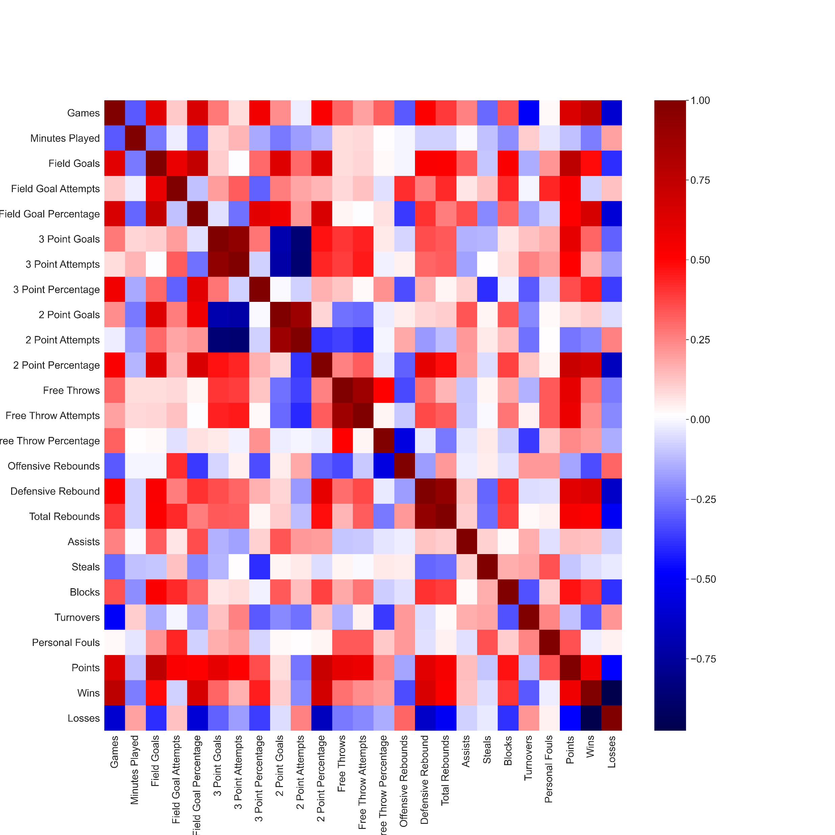
Too many variables
correlation

Slide 13
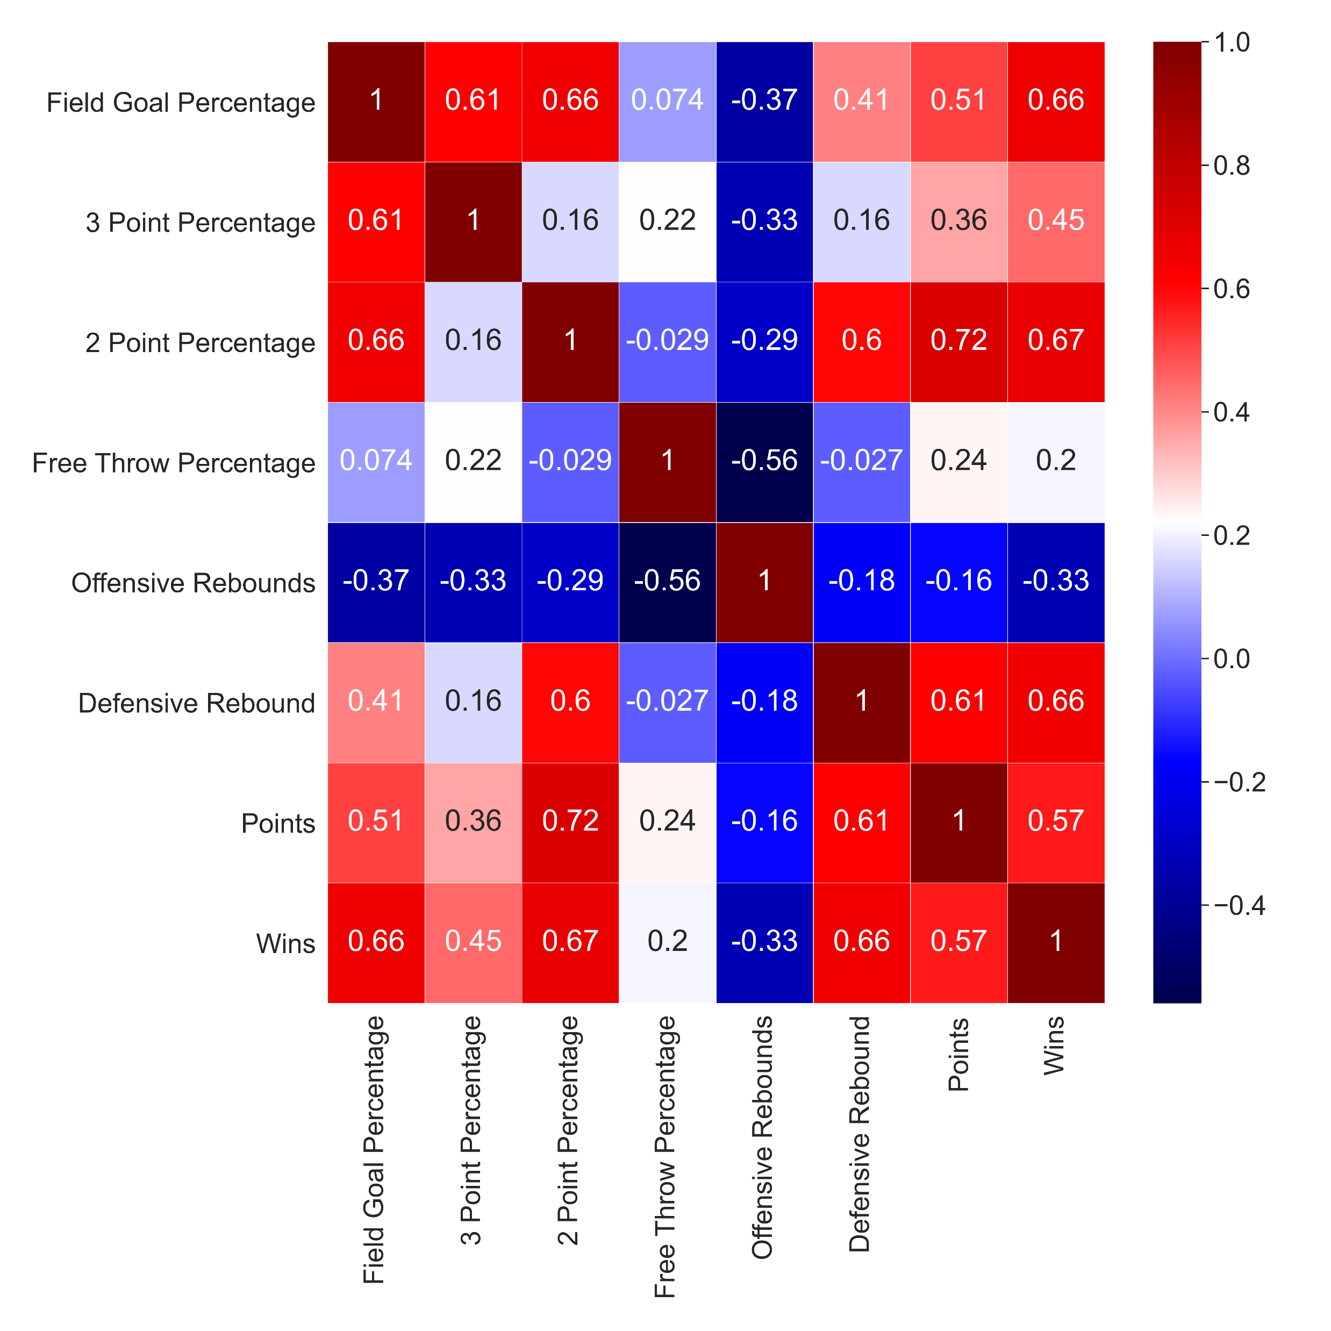
Narrowed Seaborn Heat Map What correlations can you see?
correlation

Slide 14
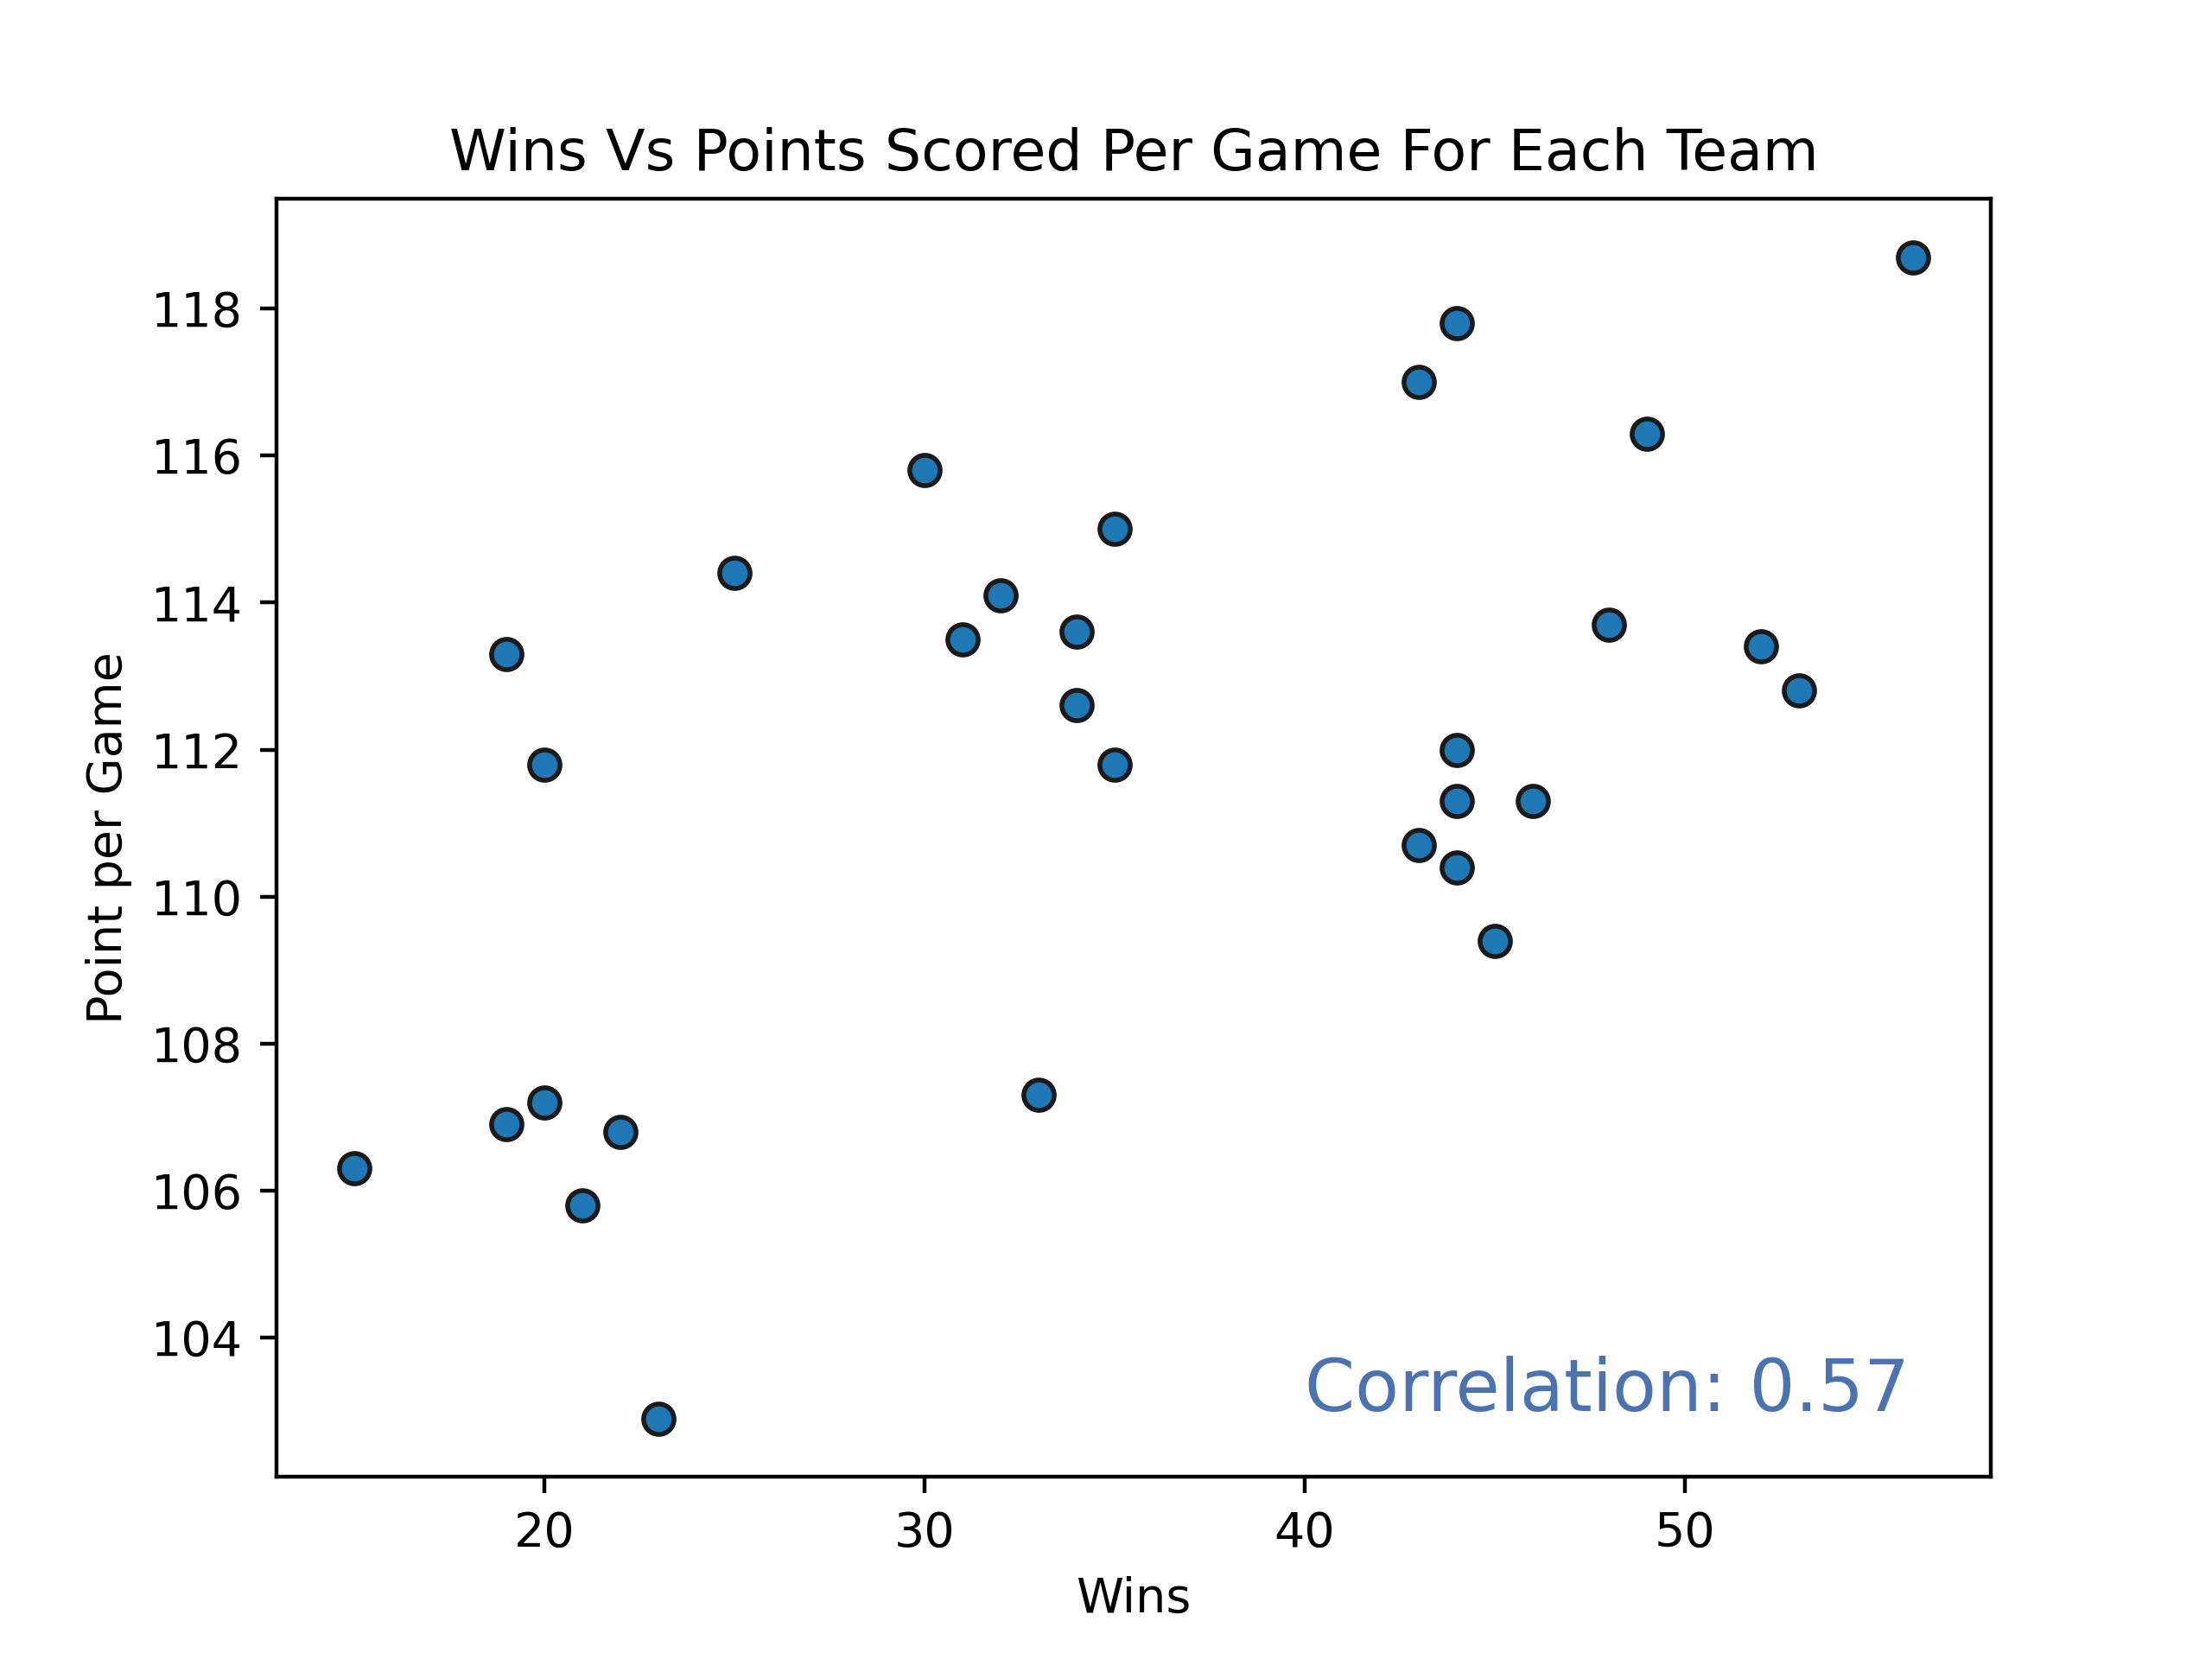
Number of Points Scored per Game is Highly Correlated to Number of Wins…. Right?

Slide 15
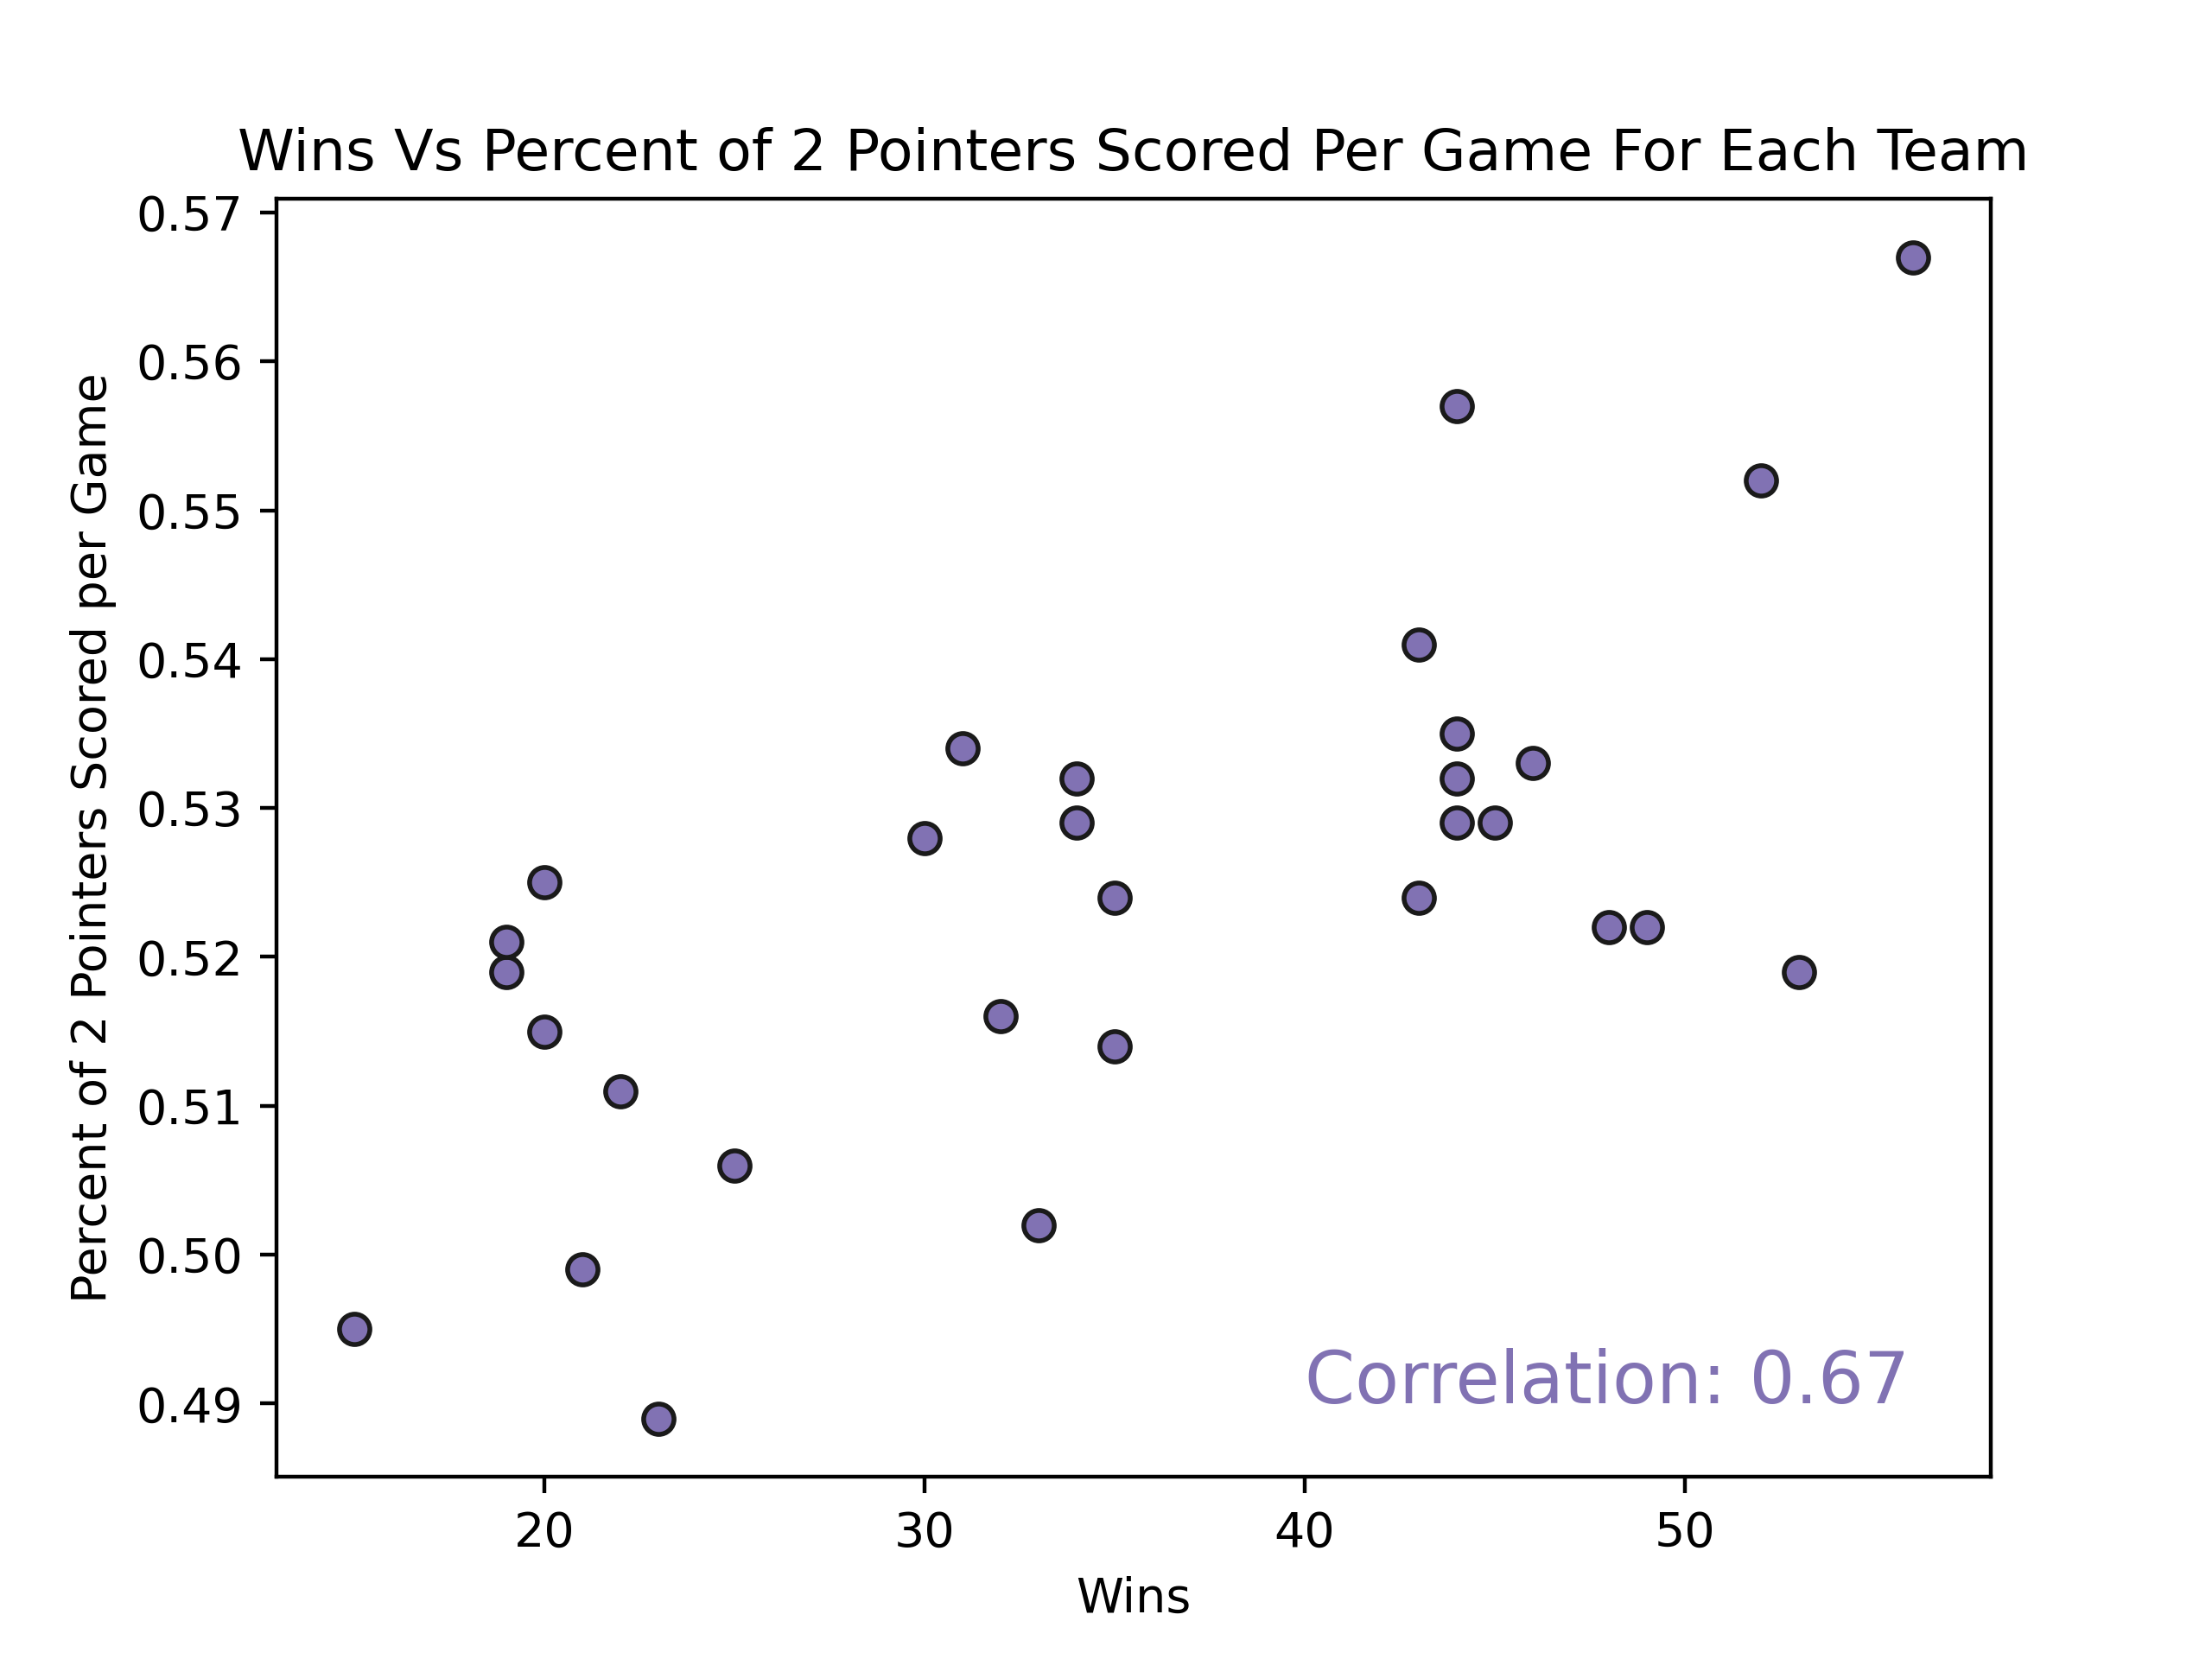
2 Points, 3 Points, or Free Throws?

Slide 16
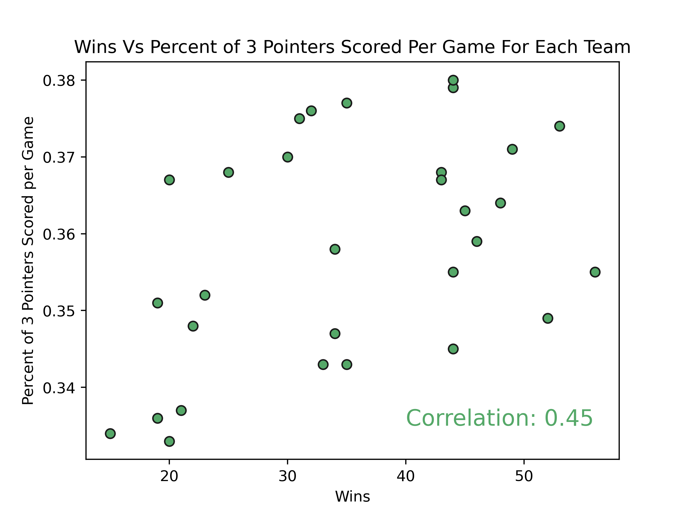

Slide 17
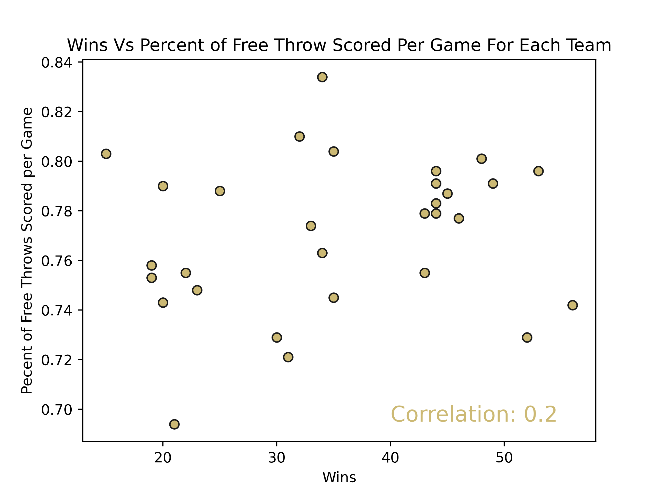

Slide 18
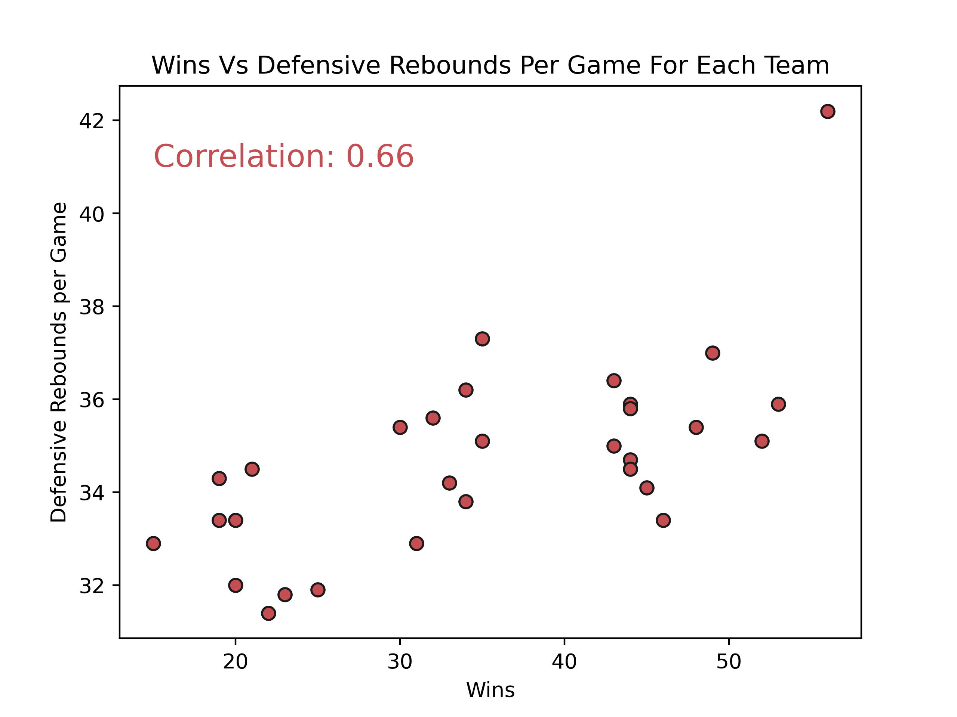
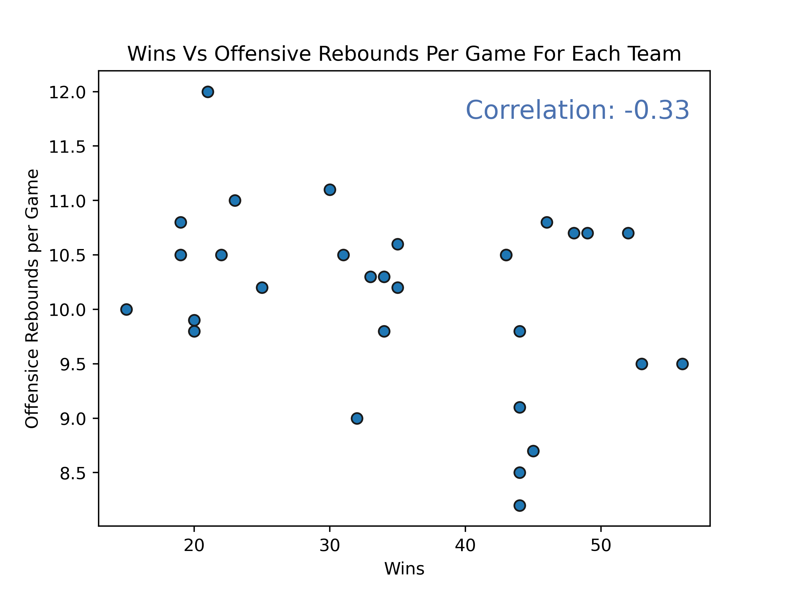
Offensive Rebound or Defensive Rebound?

Slide 19
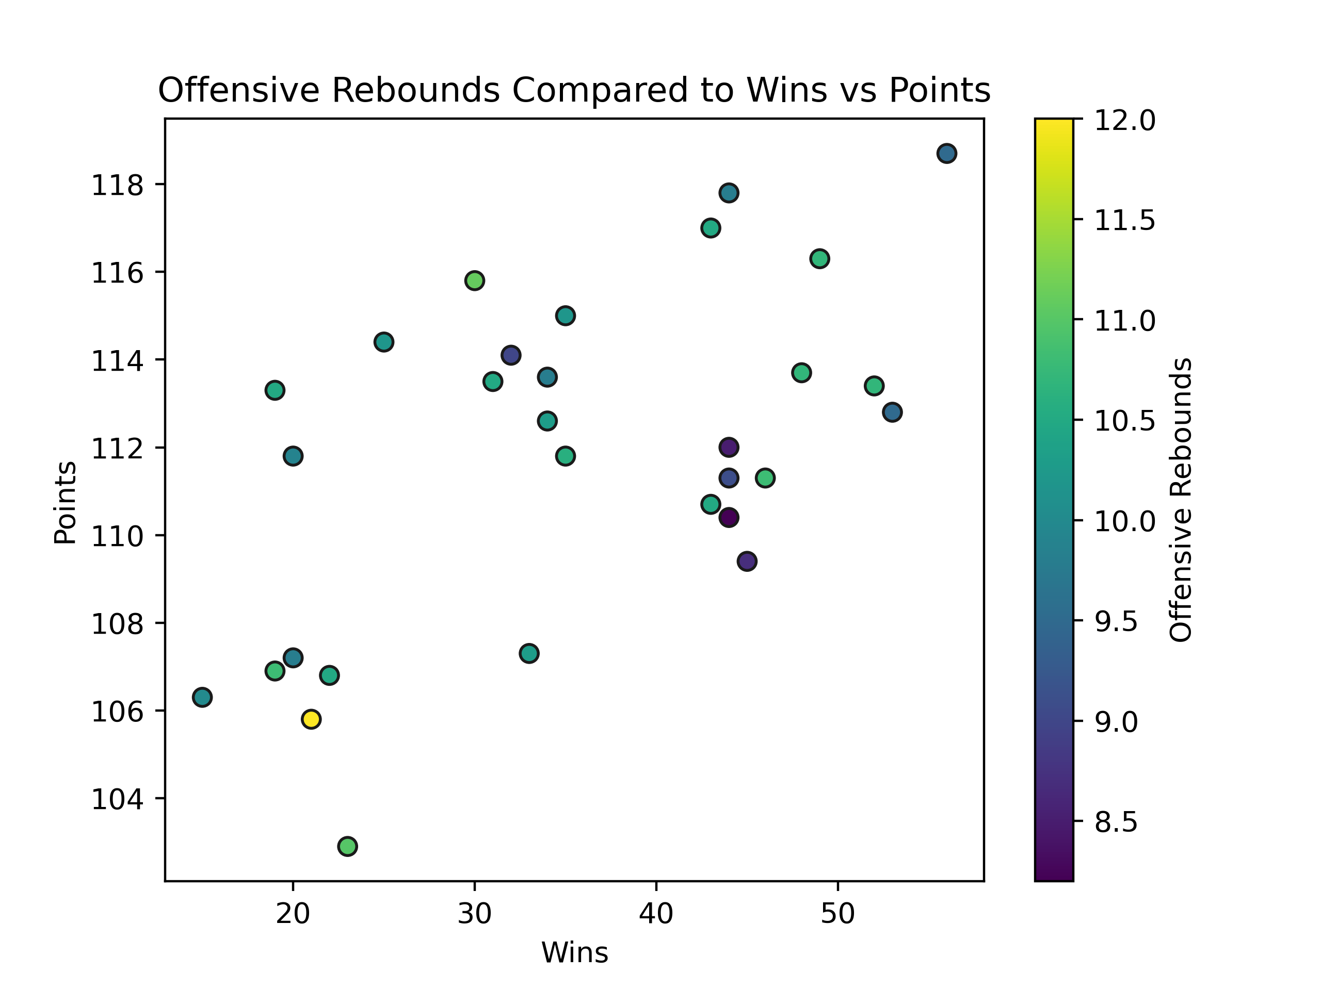
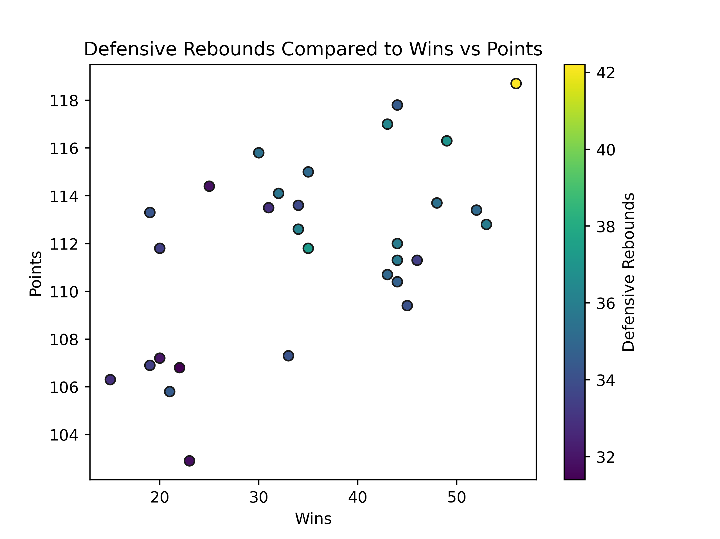
Offensive Rebound or Defensive Rebound?: In Depth Analysis

Slide 20
Using Statistical Analysis to try and predict the out of the Games
Using the correlation matrix, we able to pinpoint which stats to use with a simple prediction algorithm.
Only used 3 main variables: points each team scored, how many wins each team had, and home team advantage. Even with just these 3 variables, the calculations can get complicated.
Used 4 systems and historical data from 2019-2020 season to try and predict outcomes of the 2020-2021 season so far
Win/Loss %: using the percentage of games won to predict if a team is going to win. The team with the higher win/loss% is most likely to win
Home Team Win: always predict the home team winning
Goal Difference with Home Team Advantage: doing a series of calculations based on how many pts each team scored to create a ranking system
Ridge Regression: a special form of linear regression that considers the correlations between the variables (function part of sklearn module)

Slide 21

Ridge Regression: Explained

Slide 22
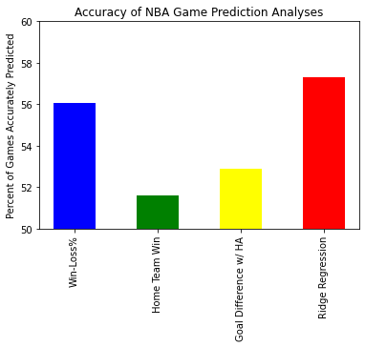
Prediction Results

Slide 23
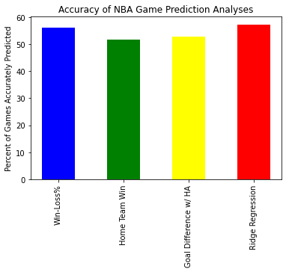
But…

Slide 24
Conclusions?
Talent matters, but not as much as you would think
Statistical analysis works and can strongly predict the outcome of games (some what)
THINK BIG: Machine Learning
We can use machine learning in the future to analyze the prediction system and to create a more complicated algorithm with more variables
We could use this to get a more detailed picture about which stats are important to basketball
What we have is a great foundation: regressions are already a common part of machine learning.
We can use this data to see if it better to bet on the spread when we have more practice with data analytics.

Slide 25

See ya Space Cowboy

